Slide 1
Proposal Workshop

Slide 2
Scheduling Updates
Next week: class on zoom
Tech Econ Seminar
March 5 (Andrey Fradkin @ Stanford)
April 2 (Zoe Hitzig @ USF)
April 30 (Ben Golub @ USF)
May 28 (TBD @ Stanford)

Slide 3
Today’s Agenda
What makes a feasible capstone project?
Potential outcomes and causal inference
Research question fine-tuning
Proposal workshop
Lightning presentations
Proposal planning

Slide 4
What makes a feasible research project?
Clear and focused research question
Data exists and is accessible
A viable design or source of variation
Reasonable scope for one semester
It’s economics (theory + causality)

Slide 5
Why scope matters
Too big: you can’t finish
Too narrow: not enough to analyze
Good scope: • one main question • one dataset (or two compatible ones) • a clear empirical strategy
For example:
“What drives unemployment?” is too big.
“Does getting fired vs. quitting affect unemployment duration?” might work (depending on data)

Slide 6
What is causality?
In short: if x hadn’t happened, y wouldn’t have happened.
Not the same as x predicting y.

Slide 7
Potential Outcomes
We compare two states of the world:
Individual is treated
Individual is not treated
In reality, we can only ever observe one outcome
We always lack data on the counterfactual

Slide 8
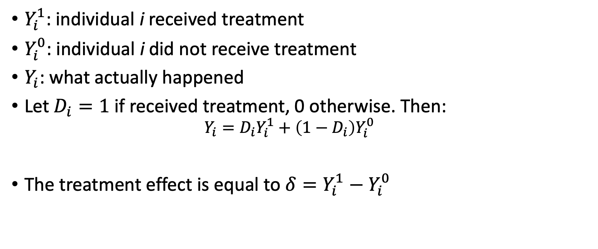
Treatment Effects

Slide 9
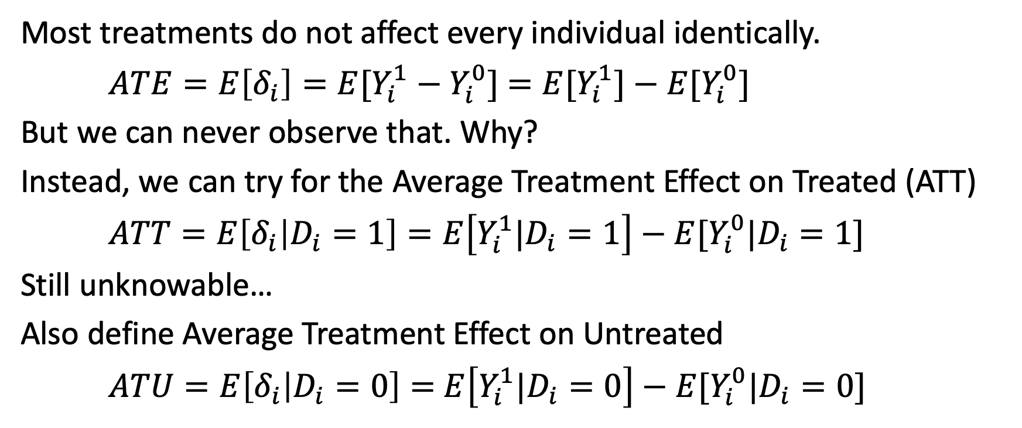
Average Treatment Effects

Slide 10
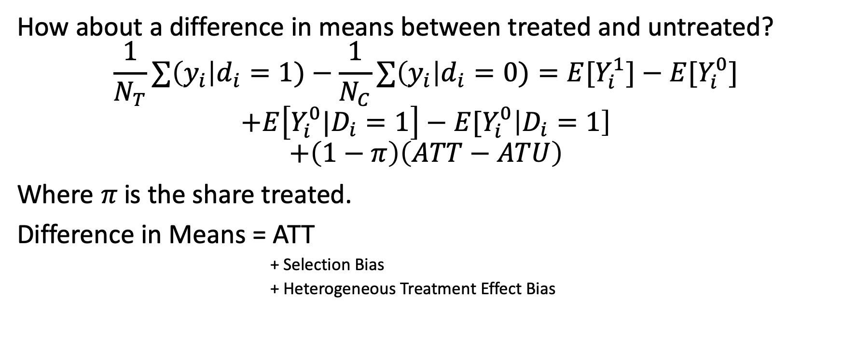
What can we do?

Slide 11
Identification Problem
We want to eliminate
Selection Bias
Heterogenous Treatment Effect Bias
We tend to focus on the first.
Today: make sure we have an identification strategy for your project.

Slide 12
Proposal Workshop

Slide 13
Sharpening your research question
What outcome are you studying?
Why does it matter?
Who or what is affected? What is the causal relationship?
What variation might allow causal inference?
What data source could support this?
Rewrite your question to be specific and testable.

Slide 14
Common pitfalls to avoid
“I will solve X for the whole world”
“I will find the perfect dataset later”
“I will use machine learning/ econometrics” with no clear plan
Too many outcomes or treatments
Available data can’t answer the question

Slide 15
Refining your question
A great project starts with a clear question.
Spend the next ~20 minutes:
Write out a clear question (1-2 sentences)
Identify a dataset
Describe your identification strategy

Slide 16
Small Group Discussion
Share your question, dataset, and identification strategy with your group.

Slide 17
Break time

Slide 18
Proposal Workshop
40 min: Create a slide or slide(s) (two maximum) based on your project idea. Begin working on a proposal if you’re ready. Try to be detailed but succinct.
Make your slide(s) here: https://tinyurl.com/692proposal.
Use template slide to check what to include - no need to explicitly include all headings.
We’ll be doing lightning presentations (3-minute timer) using these slides.
Consider writing a script - 3 minutes is very little time.

Slide 19
Lightning presentations

Slide 20
Week ahead
Submit Week 2 progress report by next Wednesday
Submit Proposal by Friday (tomorrow!)
Next week’s class will be virtual - watch canvas for the zoom link.

